Slide 2
Loading SharePoint Data in a SPFx web part
Jenkins NS

Slide 3












Jenkins NS
Modern Workplace Solution Architect | Consultant
Founder & Director @
Microsoft Teams, Power Platform and SPFx Specialist
International Speaker | Blogger | Trainer
SPS Bangalore Organizer
aOS Ambassador
jenkinsns@gmail.com
in/jenkinsns
@jenkinsns
http://www.jenkinsblogs.com
jenkinsns
https://www.facebook.com/spfxinfo/
https://www.facebook.com/msteamsinfo

Slide 4
Page Context
Web Services Overview
SharePoint REST API’s
Using HttpClient
Loading SharePoint data
Demo
- Using No JavaScript Framework
- Using React

Slide 5
Page Context
The page context provides standard definitions for common SharePoint objects that need to be shared between the client-side application, web parts, and other components. Typically the data is fetched via REST queries when navigating to a new page, but it can also be preloaded by the web server or filled from a custom application cache.
Provides access to information about current context
Greatly extended version of _spPageContextinfo
Property | Description
aadInfo | If the current page doesn't have an associated Azure Active Directory tenant, this property will be undefined
cultureInfo | It provides culture info for the current user of the application
isInitialized | Returns whether the PageContext has been initialized
list | Contextual information for the SharePoint list that is hosting the page. If there is no list associated to the current page, this property will be undefined
listItem | Contextual information for the SharePoint list item that is hosting the page. If there is no list item associated to the current page, this property will be undefined
site | Contextual information for the SharePoint site collection ("SPSite") that is hosting the page.
user | It provides contextual information for the SharePoint user that is accessing the page. This class is primarily used with the PageContext class.
web | Contextual information for the SharePoint site ("SPWeb") that is hosting the page.

Slide 6
Page Context …
Examples
import { SPPermission } from '@microsoft/sp-page-context’;
this.context.pageContext.web.absoluteUrl
this.context.pageContext.web.permissions.hasAllPermissions(SPPermission.fullMask);
hasAllPermissions : Checks if the user has all the permissions
this.context.pageContext.web.permissions.hasAnyPermissions(SPPermission.manageWeb);
hasAnyPermissions: Checks if the user has any permission from the collection of permissions
this.context.pageContext.web.permissions.hasPermission(SPPermission.viewPages);
has Permission: Checks if the user has given permission

Slide 7
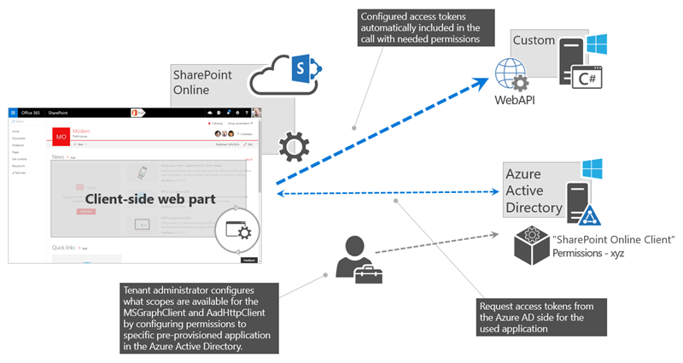
Web Services Overview
Scenario: Customer is having existing web service which is developed into ASP.NET. Currently, we need to develop SPFx web part for SharePoint application. We want to fetch some information using this web service and need to populate into this webpart.
How is authentication handled in the ASP.NET web service?
Answer: By using the AadHttpClient, you can easily connect to APIs secured by using Azure AD without having to implement the OAuth flow yourself
Developers building client-side solutions are responsible for implementing authorization by using the OAuth implicit flow in their application. In SharePoint Framework solutions, that's already done as part of the framework through MSGraphClient and AadHttpClient, both of which are introduced in SharePoint Framework v1.4.1.
Note : If you build solutions on a version of the SharePoint Framework earlier than v1.4.1, you can still connect to resources secured with Azure AD. In this case, you need to implement the OAuth implicit flow by using ADAL JS.
Notes:
https://docs.microsoft.com/en-us/sharepoint/dev/spfx/use-aadhttpclient

Slide 8
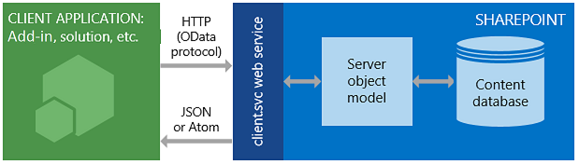
SharePoint REST API’s
SharePoint includes a Representational State Transfer (REST) service that is comparable to the existing SharePoint client object models. Developers can interact remotely with SharePoint data by using any technology that supports REST web requests. This means that developers can perform Create, Read, Update, and Delete (CRUD) operations from their SharePoint Add-ins, solutions, and client applications, using REST web technologies and standard Open Data Protocol (OData) syntax.
To access SharePoint resources using REST, construct a RESTful HTTP request by using the OData standard, which corresponds to the desired client object model API.
https://{site_url}/_api/web
https://{site_url}/_api/site
Example
https://jpower4dev.sharepoint.com/_api/web/lists/GetByTitle('Contactlist')/Items
URL end Points – Some exaples | Description
web/title | Retrieves the title of a list
Lists | Retrieves all lists on a site
lists/getbytitle('listname') | Retrieves a single list's metadata
lists/getbytitle('listname')/items | Retrieves items within a list
lists/getbytitle('listname')?select=Title | Retrieves a specific property of a document

Slide 9
Using HttpClient
HttpClient implements a basic set of features for performing REST operations against a generic service.
import { HttpClient, IHttpClientOptions, HttpClientResponse } from '@microsoft/sp-http’
If you already used the HttpClient and SPHttpClient in your SharePoint Framework projects, you might have noticed that you have two types of request methods options: GET and POST. These two types of requests are the most used ones, but what if you want to use other HTTP methods like PUT, PATCH, DELETE?
If you need to make calls with other HTTP methods, you can make use of the fetch which is available on both the HttpClient and SPHttpClient classes. The fetch method allows you to specify the HTTP method type per request yourself. Fetch is also used behind the scenes when you are using the GET and POST methods.
how you can make use of the fetch method and specifying the request method to perform: spHttpClient
this.props.context.spHttpClient.fetch(restUrl, SPHttpClient.configurations.v1, {
method: "PATCH",
body: JSON.stringify({
"Something": "Some content to patch" })
}).then((response: SPHttpClientResponse) => { // Do your thing});
with the HttpClient, but you will notice that is not that different to use:
this.props.context.httpClient.fetch(restUrl, HttpClient.configurations.v1,
{ method: "DELETE"})
.then((response: HttpClientResponse) => { // Do your thing
});zax

Slide 10
Loading SharePoint data
SharePoint Framework is the new development model and it is a page and Web part model which provides full support for client-side SharePoint development, easy integration with SharePoint data, and support for open-source tooling.
Standard “features” of SPFx
ToolchainAuthenticationSP
GraphAPI and WebAPI Access
CDN hosting
Config experience
Solution hosting
Component is able to get the right application context
Tenant-wide Deployment

Slide 11
Loading SharePoint Data
- Using No JavaScript Framework
- Using React
Download the code
https://github.com/jenkinsns/spfx-demo-webparts

Slide 12
References…
http://jenkinsblogs.com/2016/08/24/create-a-sharepoint-framework-client-webpart-retrive-list-items/
https://docs.microsoft.com/en-us/sharepoint/dev/spfx/web-parts/get-started/build-a-hello-world-web-part
https://www.youtube.com/channel/UC4JieFHDrN0elIYtZDktZSg
https://www.youtube.com/channel/UC_mKdhw-V6CeCM7gTo_Iy7w

Slide 14
SPFx with React
Siddharth Vaghasia

